Slide 1
The Functioning of the Human Being
“The Old Man” vs. “the New Man”

Slide 2
St. Paul teaches us that the human being has two “beings” or better said “ways of functioning” in him:
“The Old Man” and “the New Man”.
“For we know that our old man was crucified with him so that the body ruled by sin might be done away with, that we should no longer be slaves to sin.” (Romans 6:6)
“Therefore, if anyone is in Christ, the new creation has come: The old has gone, the new is here!” (2 Co 5:17)
“You were taught, with regard to your former way of life, to put off your old self, which is being corrupted by its deceitful desires” (Ep 4:22)

Slide 3
the spirit
Mind & Will
Inner Senses,
Imagination
Our Emotions
Our Five Senses
God
a
b
3
2
1
The New Man
The OldMan

Slide 4
Each being functions in a specific way.
The New Man, by the action of the Grace of God, uses the upper part of the Soul --the rational soul (mind and will)-- and activates it according to God’s way.
God’s way is : Acts of Faith, of Hope and of Love.

Slide 5
It is of the utmost importance to learn and excel in the practice of the theological acts of Faith, Hope and Love.
We need to learn that these acts are aimed at God, and how the Grace of God works in them.
We need to learn to repeatedly make each of these acts.

Slide 6
- The Act of Faith allows us to see things in daily life as God sees them.
- The Act of hope teaches us what God wants to give us and drives us to desire it. God wants to give Himself totally to us and be united with us.
- The Act of Love teaches us how to love God with His Love, His way, according to His means.
- The Act of Love teaches us how to love any human being the way God loves him.

Slide 7
On the other hand, the Old Man in us uses and pushes the rational soul to submit to the ways of functioning of the lower faculties: senses, emotions, imagination,...
- It shuts us off from God’s light.
- It offers us other goals in life, other hopes, other pleasures.
- It keeps us selfish, limited in our way of loving.

Slide 8
Senses, emotions, imagination,... essentially draw their way of functioning from the outer world (goals, means,...).

Slide 9
In the following diagrams we will “see” more effectively how all this works.

Slide 10
First let us see the different faculties of our being and their areas of influence.

Slide 11
Our Five Senses
Our Emotions
Inner Senses,
Imagination
Upper part of the soul: active Mind & Will
Highest part of the Soul, i.e. the spirit. Passive Mind & Will
Outer world
God dwelling in the deepest part of our being
Supernatural Anthropology

Slide 12
Let us notice the extremes:
- God who is at the centre of our being.
-The Outer World that can be reached by our five senses.

Slide 13
Each area has its own functioning designated by a & b for the upper parts of the soul (spirit, mind/will), and 1, 2, 3 for the lower parts (soul & body) :

Slide 14
Our Five Senses
Our Emotions
Inner Senses,
Imagination
Upper part of the soul: active Mind & Will.
Highest part of the Soul, i.e. the spirit. Passive Mind & Will.
Outer world
a
b
3
2
1
God dwelling in the deepest part of our being
Each faculty produces acts: a, b,1, 2, 3

Slide 15
As we can see in the following slide, the area of influence of the Old Man in us, designated by the red circle, goes roughly from the imagination to the five senses, through our emotions.

Slide 16
Our Five Senses
Our Emotions
Inner Senses,
Imagination
Upper part of the soul: active Mind & Will
Highest part of the Soul, i.e. the spirit. Passive Mind & Will
Outer world
a
b
3
2
1
God dwelling in the deepest part of our being
The Old Man area of influence

Slide 17
In themselves and by themselves these faculties are not evil.
On the contrary, they are all created by God and good.
It is their functioning that can be good or bad.

Slide 18
If their functioning idolises a created object, and draws the upper part (spirit, mind/will) to become enslaved by this created object, we are confronted here by what St. Paul calls the Old Man’s behaviour.

Slide 19
Upper part of the soul: active & Will
Inner Senses,
Imagination
Our Emotions
Our Five Senses
a
b
3
2
1
Outer world
Acting toward the outer world and drawing from the Outer World.
Action toward the outer world

Slide 20
Upper part of the soul: active & Will
Inner Senses,
Imagination
Our Emotions
Our Five Senses
b is choosing to act according to the functioning of the Old Man
a
b
3
2
1
Outer world
Acting toward the outer world and drawing from the Outer World.
The Upper Part is slave to the lower one.

Slide 21
In this case the human being seems to be split in two.
The upper part (the rational and spiritual part) knows what is good but can’t do it - it is slave to the lower part which is commanding!
“I have the desire to do what is good, but I cannot carry it out.” (Rom 7:18)
“For the flesh desires what is contrary to the Spirit, and the Spirit what is contrary to the flesh. They are in conflict with each other, so that you are not to do whatever you want.” (Gal 5:17)

Slide 22
the spirit
Mind & Will
Inner Senses,
Imagination
Our Emotions
Our Five Senses
a
b
3
2
1
The New Man
The OldMan

Slide 23
The human being looks like a woman pregnant with twins who are fighting each other. The “New Man” and the “Old Man”.
The more we activate the New Man’s way of thinking, aiming/desiring, loving, the more the Old Man, will correspondingly shrink.

Slide 24
the spirit
Mind & Will
Inner Senses,
Imagination
Our Emotions
Our Five Senses
a
b
3
2
1
God’s Influence
The World’s Influence

Slide 25
the spirit
Mind & Will
Inner Senses,
Imagination
Our Emotions
Our Five Senses
a
b
3
2
1
The New Man
The OldMan

Slide 26
The Acts of Faith, Hope and Love, made by the active mind and will, through the grace of God, unite us with Him.
“The life I live in the body, I live by faith in the Son of God, who loved me and gave Himself up for me.” (Ga 2:20)
a
b
The New Man Functioning

Slide 27
the spirit
Mind & Will
Inner Senses,
Imagination
Our Emotions
Our Five Senses
a
b
3
2
1
God’s Influence
The World’s Influence

Slide 28
Even in our spiritual life, we still have both ways of functioning. This results from the effort of our virtuous work, with the general help of God. And what comes from God and will be refrated in our conscious part (mind, emotions, senses).

Slide 29
When we read St. Teresa of Avila’s description of what we can feel (during prayer for instance or outside of it) she compares two “feelings” that can occur in us, but she underlines how different they are from each other.
She offers this description in the Fourth Mansions Chapter I.

Slide 30
In this chapter she treats of “the difference between sweetness or tenderness in prayer and consolations”. (4th Mansions, Chapter 1)

Slide 31
She says that one can feel sweetness and feel consolations.
Behind these words what matters is what they allude to, from where these feelings come and what is at stake in each one.

Slide 32
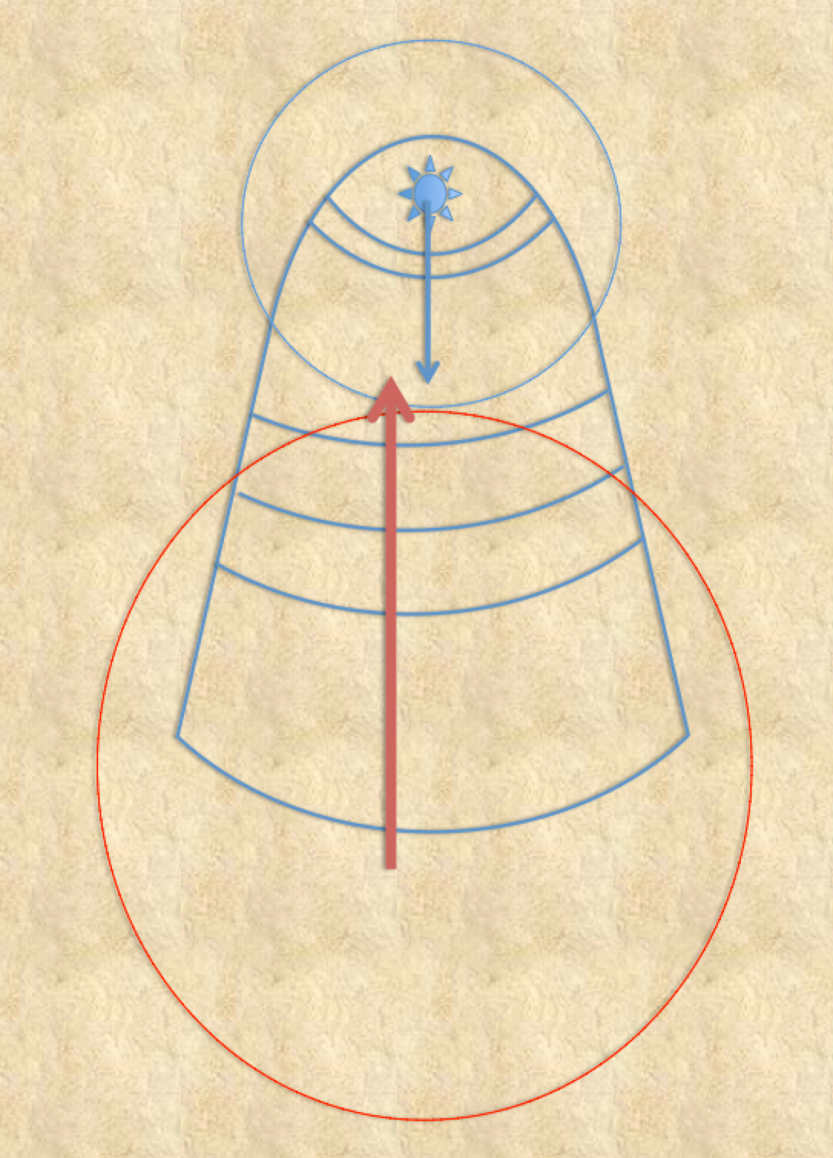
In a way we can say that one, the consolations, comes from above (or deep inside), from God Himself, toward the lower part (or outer).
And the other one, the sweetness, comes from bottom to top (or outer to inner).

Slide 33
“it seems to me that we may describe as sweetness what we get from our meditations and from petitions made to Our Lord. This proceeds from our own nature, though, of course, God plays a part in the process (and in everything I say you must understand this, for we can do nothing without Him). This spiritual sweetness arises from the actual virtuous work which we perform, and we think we have acquired it by our labours.” (4th Manions Chapter 1)

Slide 34
Speaking about the Consolations that come from God she says:
“It seems to me that the feelings which come to us from Divine things are as purely natural as these, except that their source is nobler, although these worldly joys are in no way bad.” (4th Manions Chapter 1)

Slide 35
“To put it briefly, worldly joys (pleasures) have their source in our own nature and end in God, whereas spiritual consolations have their source in God, but we experience them in a natural way and enjoy them as much as we enjoy those I have already mentioned, and indeed much more. ”
(4th Mansions Chapter 1)

Slide 36
There is one “feeling”, a pleasure, that comes from the outer world. Some circumstances, news, events, persons we meet,... can bring us pleasure.
The direction of the arrow is from outside to inside.
As we can see it in the Old Man functioning. There is nothing bad in that.

Slide 37
The other “feeling”, a joy, a consolation, that comes from God, through the spirit, is refracted* into the upper part of the soul and can be sometimes refracted* too into the feelings and senses.
This is the result of the action of the grace of God in us.
*“refracted”: because it is not the grace itself; it is like a created reflection of it that falls either or in the mind, the imagination, emotions senses.
St. Teresa of Avila doesn’t offer this explanation. It is St. John of the Cross, master of discernment, who offers it in his general teaching.

